Slide 1
SMART AGRICULTURE SYSTEM USING IOT
SUBMITTED BY:
K.RUSHI KIRAN KUMAR
rushikirankuchipudi@gmail.com

Slide 2
AIM
TO CREATE A SMART AGRICULTURE SYSTEM USING IOT TO PROVIDE FARMERS WITH THE POWER OF MODERN TECHNOLOGY

Slide 3
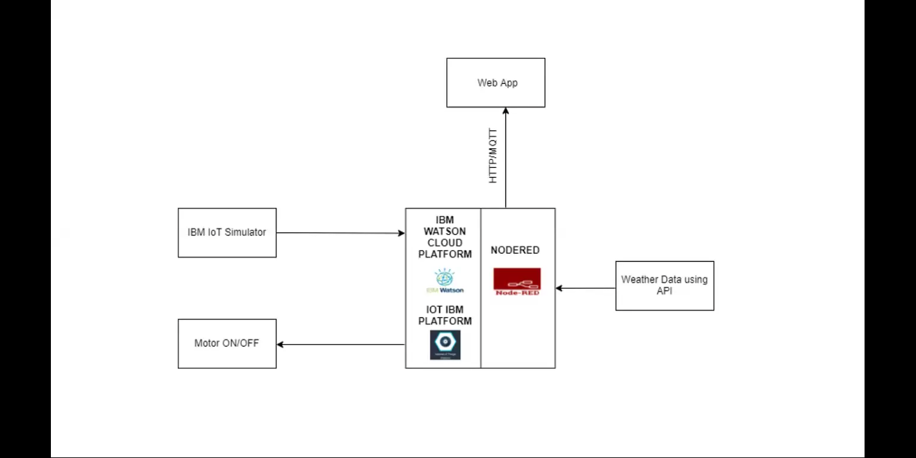
FLOWCHART

Slide 4
HOW?
We use,
IBM Watson IoT platform
Node-red
OpenWeatherMap API
Python
With the integration of these three tools, we provide the farmer the weather and soil conditions of his field and locality and also…
A web UI for the farmer to visualise the weather parameters..

Slide 5
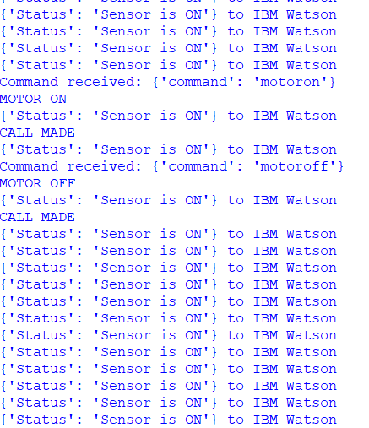
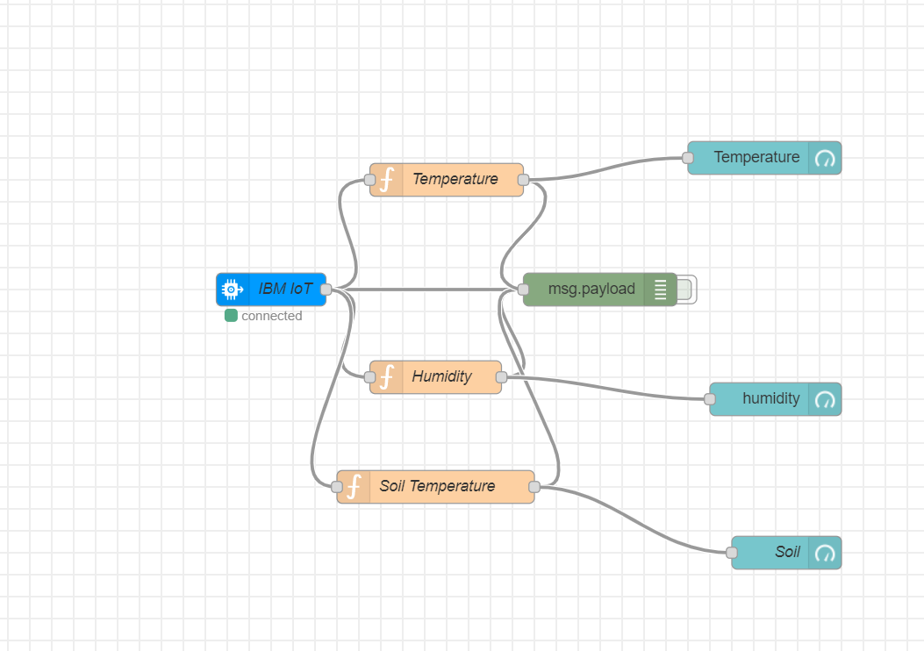
Also,the farmer can control the motor with a python script

Slide 6
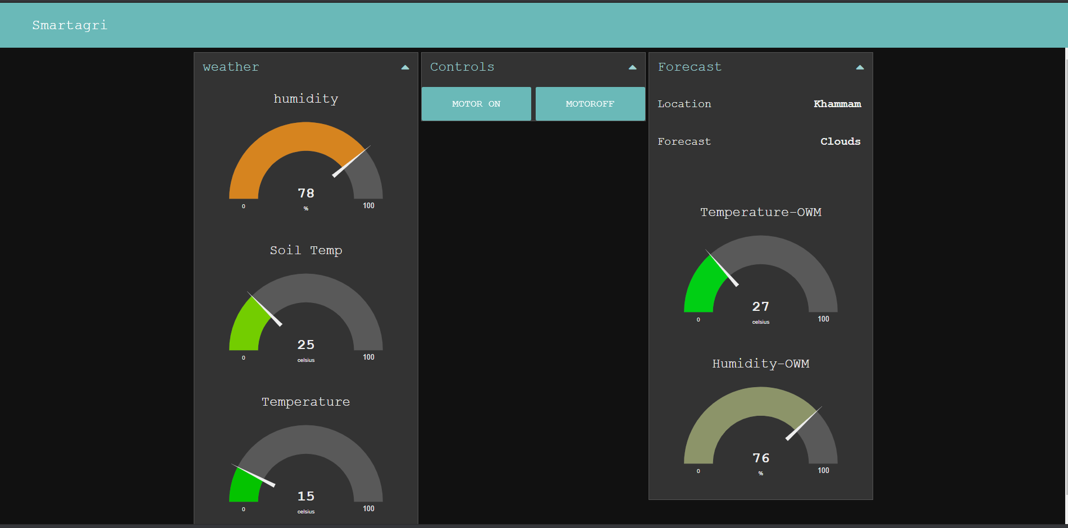
THE FARMER HAS THE FINAL DASHBOARD..

